Slide 1

AWS Digital Marketing Email Subscription Platform
By Shobharani

Slide 2

Content
Introduction
AWS System Architecture, Implementation Steps
Creating a New S3 Bucket
Creating a DynamoDB Table
Setting Up AWS Lambda and API Gateway
Integrating the Subscription Form with the Backend
Configuring Amazon SES for Email Communications
Test the Subscription Flow
Launching the project
Demonstration
Results and Performance Analysis
Challenges and Solutions
The Business Impact

Slide 3
Introduction
Digital Marketing Email Subscription Platform using AWS services.
Digital Communication Vital: Effective communication is crucial for business success, with email marketing playing a pivotal role.
AWS Platform: creating a Digital Marketing Email Subscription Platform on AWS, utilizing its powerful services.
Project Components: A static website on Amazon S3, implementing a subscription form, backend setup with AWS Lambda and API Gateway, data storage in Amazon DynamoDB, and email management with Amazon SES.
Versatile Solution: Project offers a scalable solution to enhance your email marketing efforts.
Empowerment Through Knowledge: Creating a robust Digital Marketing Email Subscription Platform on AWS, driving effective audience engagement and business growth.

Slide 4
Project Overview
Static Website Deployment on Amazon S3: Deploy a static website hosting a subscription form on Amazon S3.
Subscription Form Integration with API Gateway: subscription form with API Gateway to trigger data processing.
Serverless Data Processing with AWS Lambda: AWS Lambda to create serverless functions that respond to API Gateway.
Data Storage and Management with Amazon DynamoDB: Store and manage subscriber information in Amazon DynamoDB.
Email Subscription Confirmation with Amazon SES: Integrate Amazon Simple Email Service to manage email communications.
Ongoing Engagement via Amazon SES Email Campaigns: Utilize Amazon SES for ongoing email marketing efforts.

Slide 5
Setting Up Amazon S3
A frontend for our subscription platform.
created a static website hosted on Amazon S3, which will serve as the user interface for subscribing to our email updates.
Let's dive into the AWS Management Console.
S3 bucket for website hosting. (Region: US East (N. Virginia)us-east-1)
Bucket Name: shobhas3bucketwebsite
Uploaded HTML files: index.HTML, subscription-form.html, thankyou.html

Slide 6
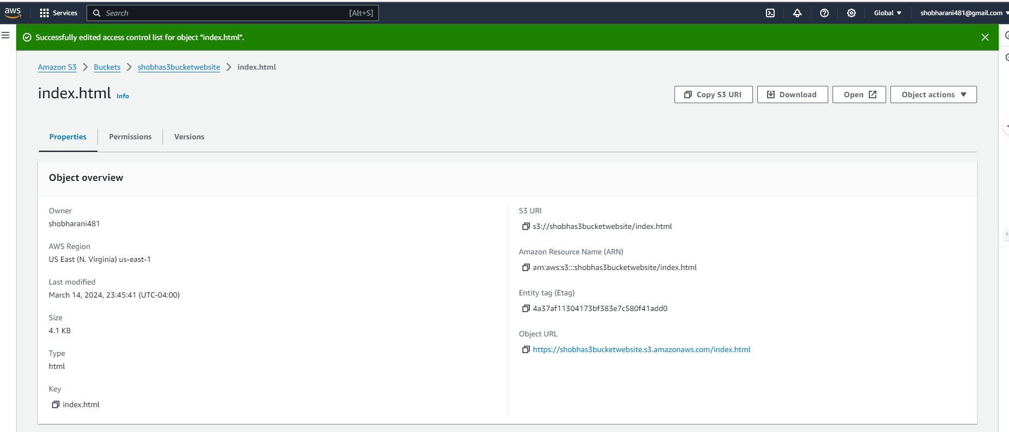
shobhas3bucketwebsite

Slide 7
S3 buckets
file:///F:/1%20SE-655-50%20Cloud%20Computing/index.html
https://s3.console.aws.amazon.com/s3/upload/shobhas3bucketwebsite?region=us-east-1&bucketType=general
https://s3.console.aws.amazon.com/s3/object/shobhas3bucketwebsite?region=us-east-1&bucketType=general&prefix=index.html
https://shobhas3bucketwebsite.s3.amazonaws.com/index.html
Website Hosting on Amazon S3: The static website was successfully deployed to an S3 bucket, providing a fast and reliable user experience. The integration with Amazon CloudFront ensured low latency and secure delivery of the content.

Slide 8
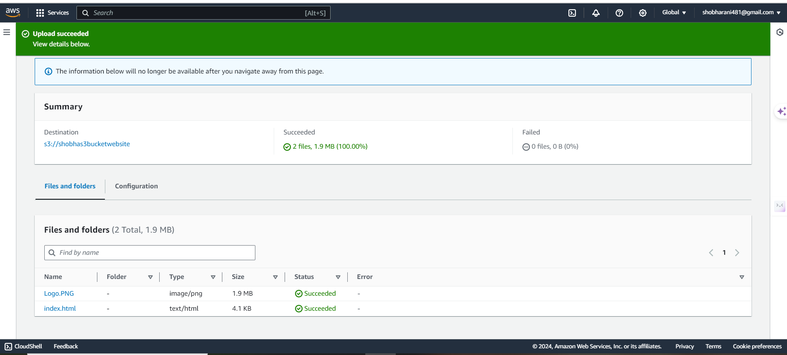
s3://shobhas3bucketwebsite

Slide 9
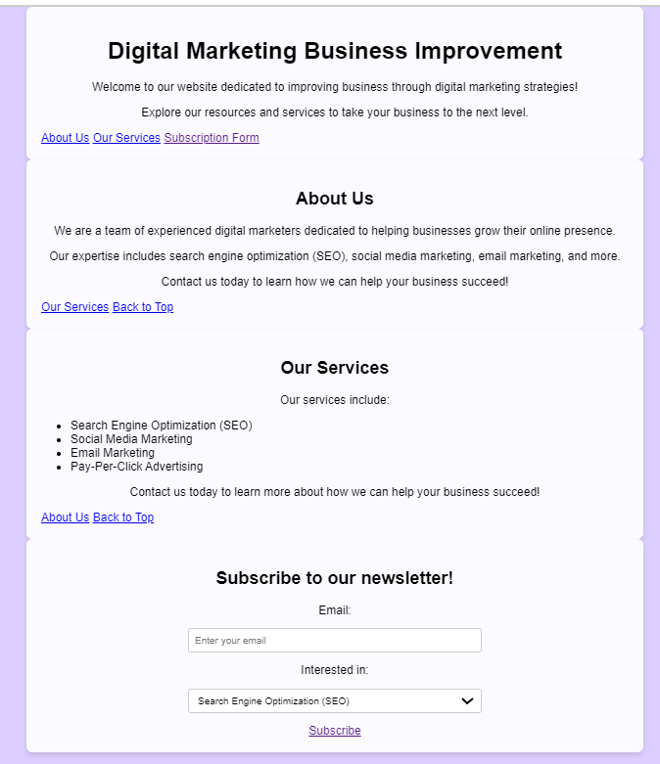
Digital Marketing Business Improvement
file:///F:/1%20SE-655-50%20Cloud%20Computing/index.html https://shobhas3bucketwebsite.s3.amazonaws.com/index.html

Slide 10
Result of the S3 process
Established Infrastructure: Implemented Amazon S3 for static website hosting, providing a stable and scalable foundation for the subscription platform.
Increased Accessibility: Static website hosting on S3 enhances accessibility, allowing users globally to access the subscription platform with an internet connection.
Improved Security: Configured S3 bucket policies and IAM roles to strengthen the security of the static website, safeguarding against unauthorized access.
Enhanced User Experience: Optimized hosting settings for faster content delivery, leading to a more responsive and seamless user experience on the subscription platform.
Ready for Integration: Prepared the S3 environment for integration with AWS services like API Gateway and Lambda, ensuring a cohesive and functional subscription workflow.
These results demonstrate that the S3 hosting solution is well-configured to support the static aspects of the digital marketing platform, contributing to a secure, accessible, and user-friendly experience while being primed for backend integration.

Slide 11
DynamoDB Table
A reliable database to store subscriber information securely.
Utilize Amazon DynamoDB,
A fully managed NoSQL database service provided by AWS. This will ensure that our platform can handle data efficiently and at scale.
Process:
DynamoDB table: 'EmailSubscribers' for storing subscription data.
DynamoDB service in the AWS Management Console:
a new table:
Table name: EmailSubscribers
Partition key: email (String)
Use default settings for everything else and Create.
https://us-east-1.console.aws.amazon.com/dynamodbv2/home?region=us-east-1#tables

Slide 12
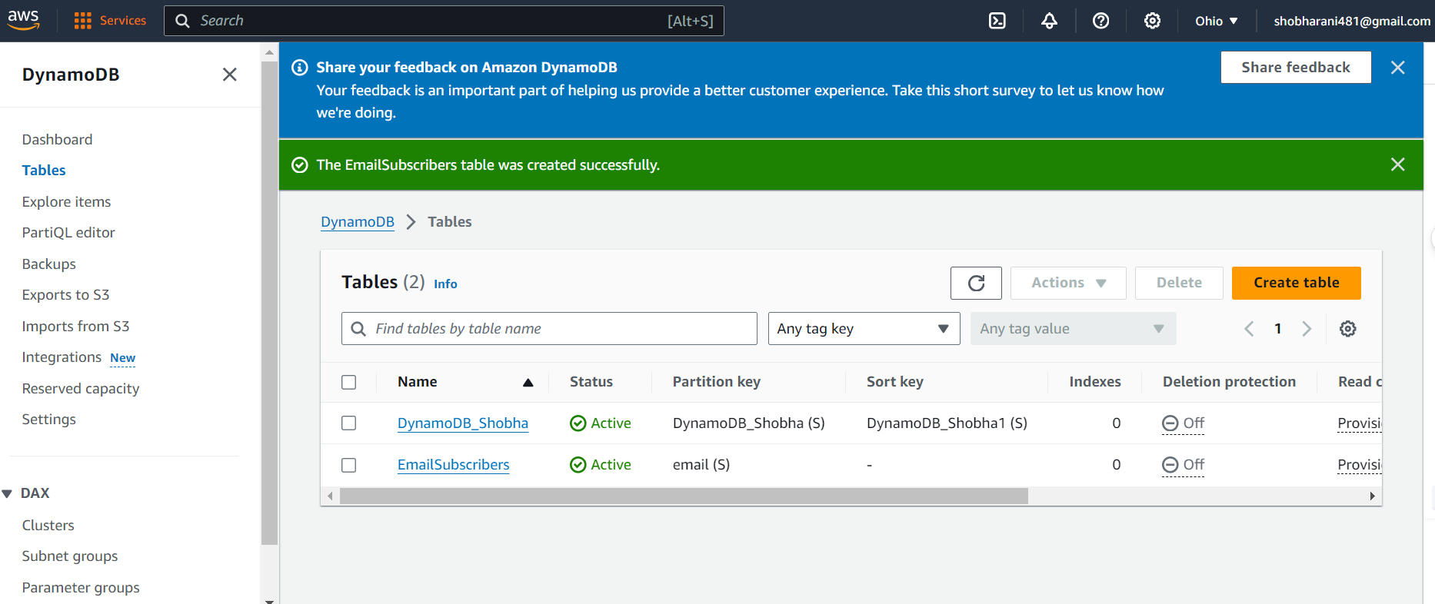
EmailSubscribers
Data Storage in Amazon DynamoDB: Subscriber data was stored in a DynamoDB table, showcasing the database's ability to handle high-velocity data and auto-scale with consistent performance.

Slide 13
AWS Lambda and API Gateway
The backend logic of our platform.
use AWS Lambda, along with API Gateway to handle incoming subscription requests, a serverless compute service.
This serverless architecture allows us to execute code in response to events without the need to manage servers.
Set up a Lambda function for subscription logic and use API Gateway for form submissions.

Slide 14
API Gateway & AWS Lambda for Subscription Handling
Amazon API Gateway was configured to handle POST requests from the subscription form, invoking the corresponding AWS Lambda function. The Lambda function efficiently processed incoming data and handled server-side logic without provisioning servers, demonstrating the power of serverless architecture.
LAMDA name: processEmailSubscription
Test code:
Event name: myeventname1
// index.mjsimport AWS from 'aws-sdk';const dynamoDb = new AWS.DynamoDB.DocumentClient();const ses = new AWS.SES();export const handler = async (event) => { const { email } = JSON.parse(event.body); const dbParams = { TableName: 'EmailSubscribers', // Ensure this table exists in DynamoDB Item: { email }, }; const sesParams = { Source: 'YOUR_VERIFIED_EMAIL_ADDRESS', // Replace with your verified SES email address Destination: { ToAddresses: [email] }, Message: { Subject: { Data: 'Subscription Confirmation' }, Body: { Text: { Data: 'Thank you for subscribing!' } }, }, }; try { await dynamoDb.put(dbParams).promise(); await ses.sendEmail(sesParams).promise(); return { statusCode: 200, body: JSON.stringify({ message: 'Subscription successful' }) }; } catch (err) { console.error('Error:', err); return { statusCode: 500, body: JSON.stringify({ message: 'Error processing subscription' }) }; }};

Slide 15
CODE (Javascript)
Index.mjs
const AWS = require('aws-sdk');const dynamoDb = new AWS.DynamoDB.DocumentClient();const ses = new AWS.SES();exports.handler = async (event) => { // Parse the JSON body from the event const { email } = JSON.parse(event.body); // Parameters for DynamoDB to store the email const dbParams = { TableName: 'EmailSubscribers', // Replace with your DynamoDB table name Item: { email: email, // Assuming 'email' is the primary key // Add additional fields as necessary }, }; // Parameters for SES to send confirmation email const sesParams = { Source: 'shobharani1211@gmail.com', // Replace with your verified SES email address Destination: { ToAddresses: [email] }, // Send to the subscribed email Message: { Subject: { Data: 'Subscription Confirmation' }, Body: { Text: { Data: 'Thank you for subscribing to our newsletter!' } } }, }; try { // Attempt to store the subscription in DynamoDB await dynamoDb.put(dbParams).promise(); // Attempt to send a confirmation email await ses.sendEmail(sesParams).promise(); // Return a successful response return { statusCode: 200, body: JSON.stringify({ message: 'Subscription successful' }), }; } catch (err) { console.error('Error processing subscription:', err); // Return an error response return { statusCode: 500, body: JSON.stringify({ message: 'Error processing subscription' }), }; }};

Slide 16
JSON for an API Gateway test event
{ "body": "{\"email\":\"test@example.com\"}", "resource": "/subscription", "httpMethod": "POST", "isBase64Encoded": false, "queryStringParameters": null, "pathParameters": null, "stageVariables": null, "headers": { "Content-Type": "application/json" }, "requestContext": { "resourceId": "123456", "apiId": "example123", "resourcePath": "/subscription", "httpMethod": "POST", "requestId": "c6af9ac6-7b61-11e6-9a41-93e288c6a7a7", "accountId": "123456789012", "stage": "test-invoke-stage", "identity": { "apiKey": null, "userArn": null, "cognitoAuthenticationType": null, "caller": null, "userAgent": "Custom User Agent String", "user": null, "cognitoIdentityPoolId": null, "cognitoIdentityId": null, "cognitoAuthenticationProvider": null, "sourceIp": "127.0.0.1", "accountId": null }, "extendedRequestId": null, "path": "/subscription" }, "path": "/subscription"}

Slide 17
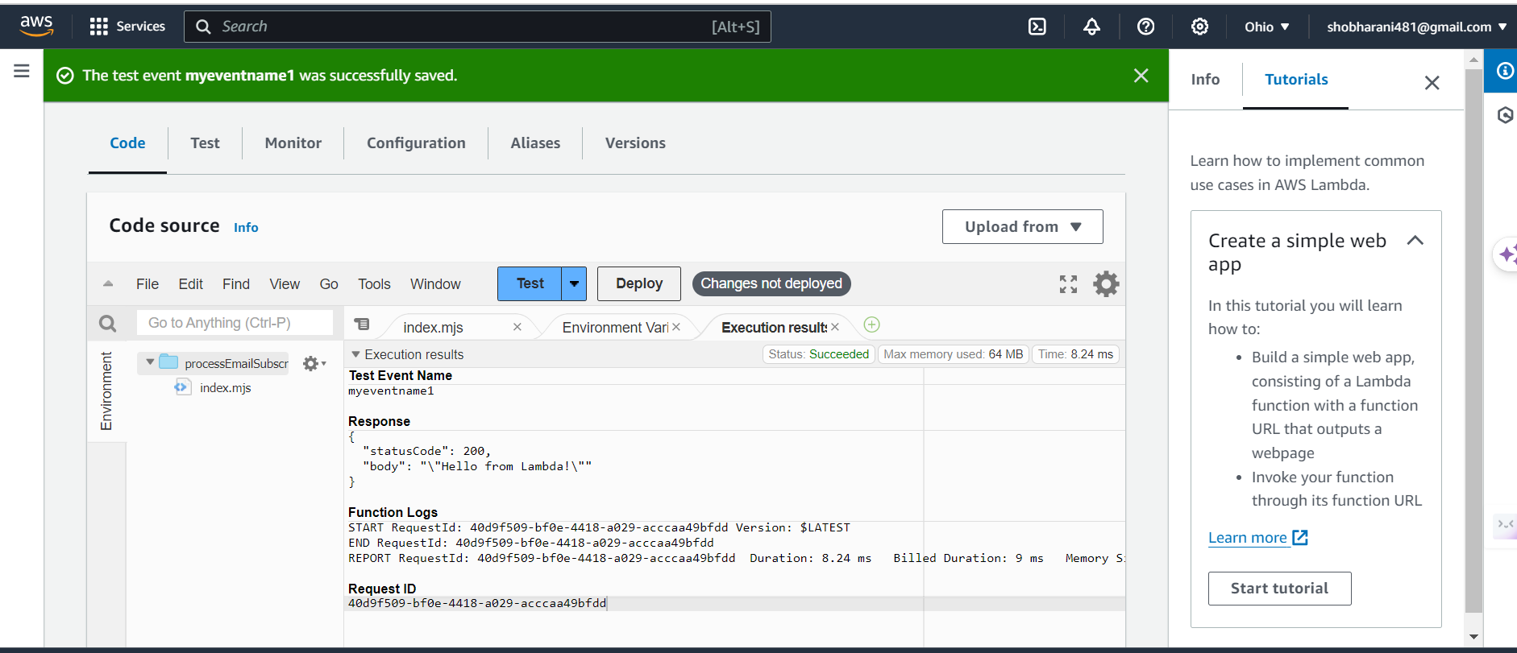
Test Event

Slide 18
Set Up API Gateway
API Gateway: API Gateway service in the AWS Management Console.
Create a New API: EmailSubscriptionAPI,
Create a New Resource and Method: The "/" resource and click on "Actions" > "Create Resource". Name it subscription, With the subscription resource selected, click on "Actions" > "Create Method" and select "POST". Configure the POST method integration to invoke your processEmailSubscription Lambda function.
Deploy API:
a new Deployment by selecting "Actions" > "Deploy API". Choose "[New Stage]" and name it (e.g., prod).

Slide 19
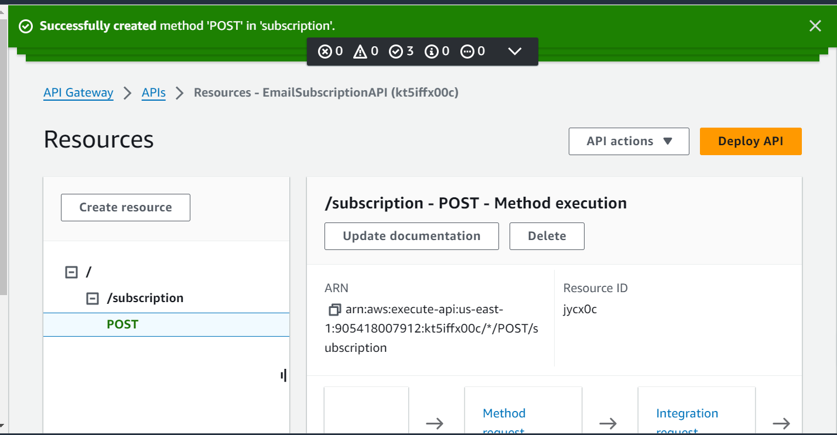
API Gateway> APIs

Slide 20
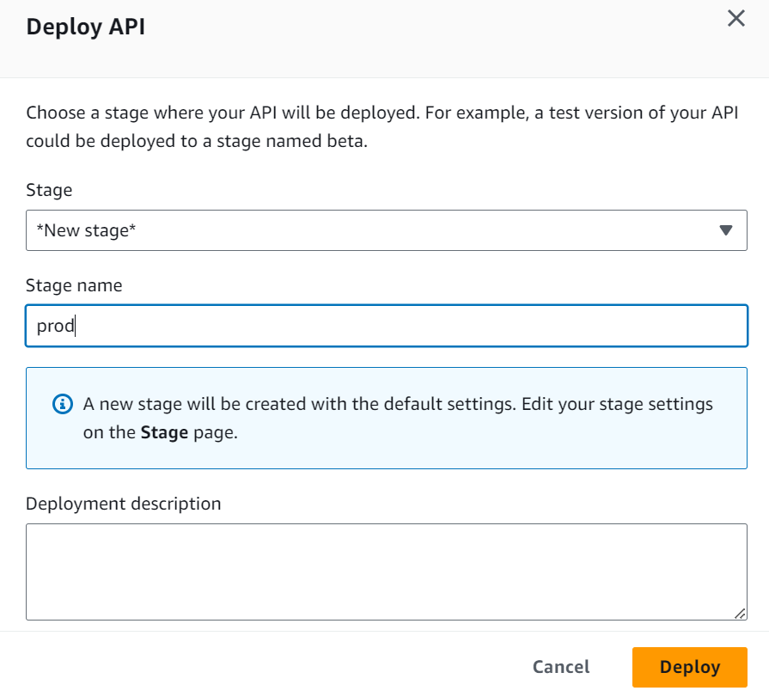
Deploy API
Created Deployment: Clicked on "Actions" and select "Deploy API". Created a new stage, e.g., prod, and deploy your API.
Note the Invocation URL: After deployment, I'll be given an invocation URL. This is what I'll use as the endpoint to
Created Deployment: Clicked on "Actions" and selected "Deploy API".
Created a new stage, e.g., prod, and deploy your API.
Note the Invocation URL: After deployment, I'll be given an invocation URL. This is what I'll use as the endpoint for your subscription form's action attribute. I have done subscription form's action attribute.

Slide 21
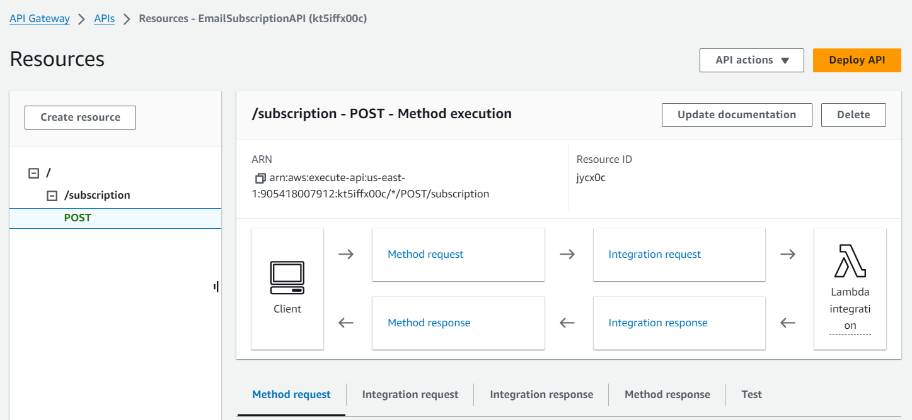
API Gateway APIs Resources - EmailSubscriptionAPI

Slide 22
Form Integration
Integrated the subscription form with the backend through API Gateway.
Integrate with Your Frontend
Updated the subscription form's JavaScript to use the API Gateway endpoint for form submissions,
Replacing ‘Business_API_GATEWAY_ENDPOINT' with the Invoke URL from API Gateway

Slide 23
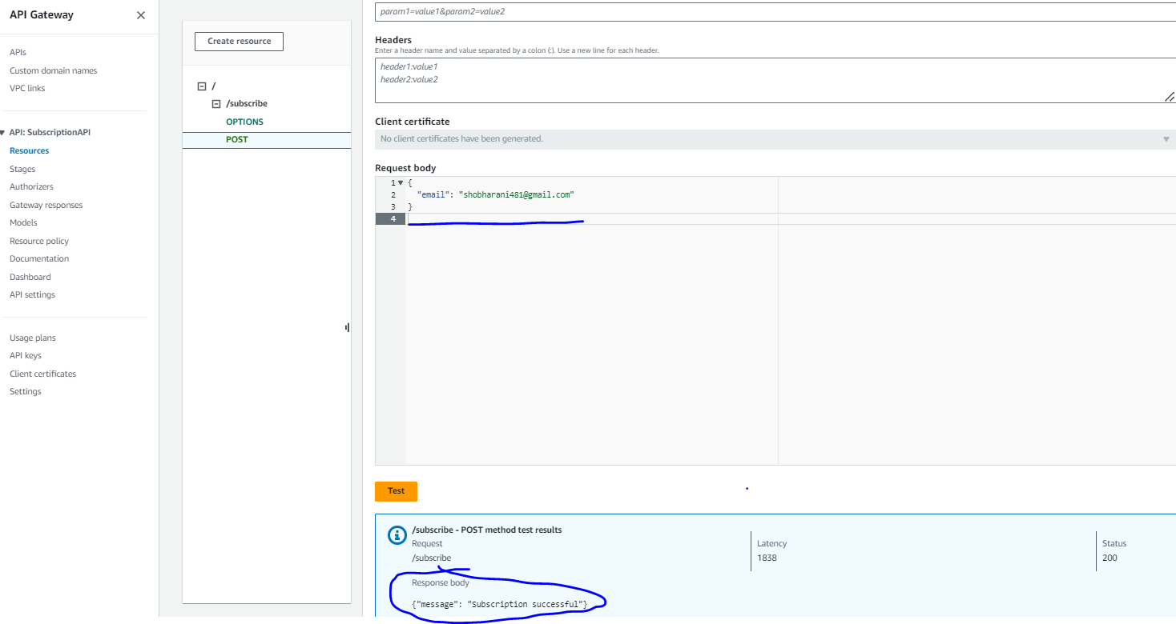
/subscribe - POST - Method execution, Deploy API, Testing

Slide 24
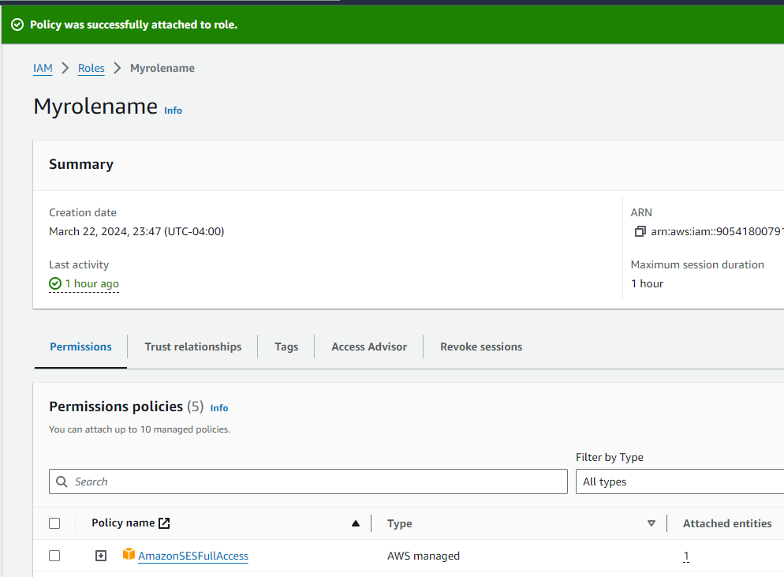
IAM Role
AWS IAM console→Myrolename→ Attach a policy to this role that grants ses:SendEmail permissions.
https://us-east-1.console.aws.amazon.com/ses/home?region=us-east-1#/account

Slide 25
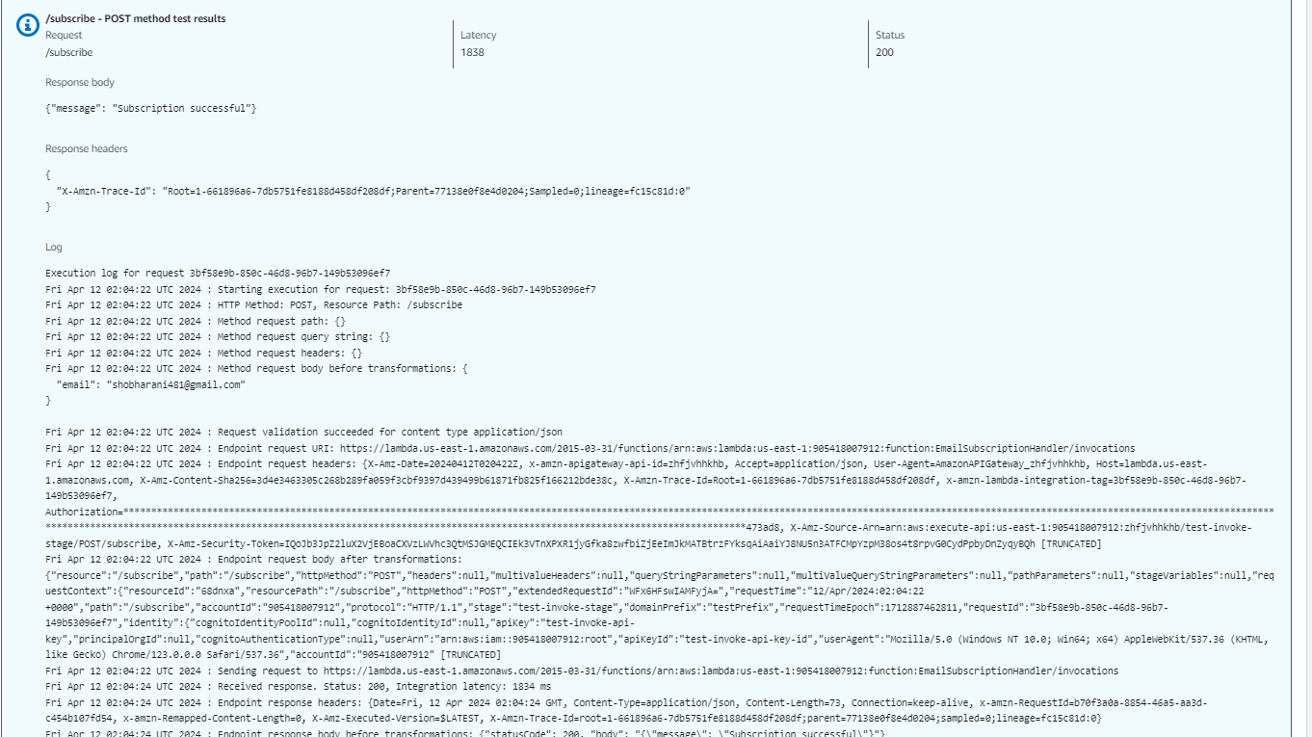
{"message": "Subscription successful"}

Slide 26
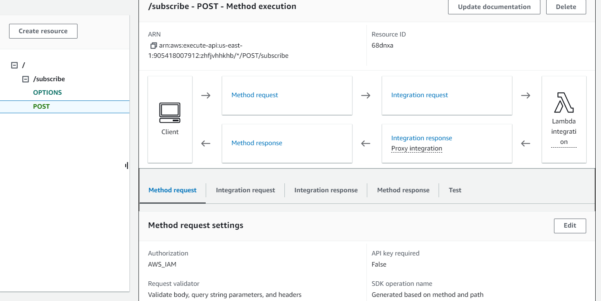
API GateWay
userId=1234
headerName:headerValue
{ "email": “shobharani123123@gmail.com", "name": “Shobha"}

Slide 27
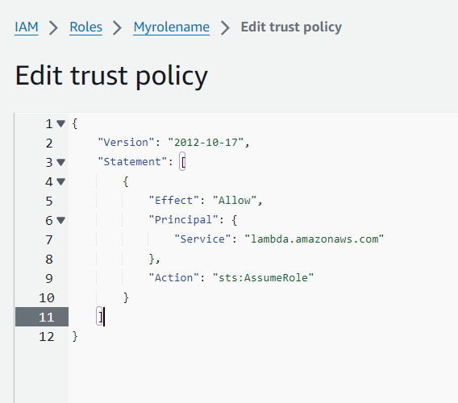
IAM role, Trust policy
These results ensure that the backend services for the digital marketing platform operate securely and effectively, with proper permissions and trust relationships in place.

Slide 28
IAM Role and Trust Policy Implementation
IAM Role Configuration: Created an IAM role designated for AWS Lambda to interact securely with other AWS services.
Trust Policy Establishment: Established a trust policy that allows Lambda to assume the IAM role.
Permissions Assignment: Assigned necessary permissions to the IAM role to access Amazon DynamoDB & Amazon SES.
Secure Access to AWS Resources: Configured the IAM role to provide secure access to AWS resources needed for subscription processing and email sending.
Least Privilege Principle: Applied the principle of least privilege to ensure the IAM role has only the permissions necessary to perform its tasks.
Role Trust Relationship: Set up the role trust relationship to ensure that the AWS Lambda service can assume IAM role.
Access Testing: Successfully tested the IAM role to verify that AWS Lambda functions can access DynamoDB and SES without security issues.
Policy Versioning and Audits: Enabled policy versioning for the IAM role to keep track of changes and facilitate audits.
Automation of Role Deployment: Utilized infrastructure as code (IaC) practices to automate the deployment of the IAM role and trust policy.

Slide 29
Amazon SES Configuration
Configure Amazon SES for email verification and to send subscription confirmations.
Testing and Launch:
Performed end-to-end testing, optimize resources, and launch the marketing platform.
Email Management with Amazon SES: Amazon SES was used for sending confirmation emails and managing email campaigns. Its reliable deliverability and comprehensive monitoring tools helped maintain high engagement rates.

Slide 30
Integration & Testing Deployment & Access Control
Seamless System Integration and Comprehensive Testing
Successfully integrated website forms with API Gateway, confirming accurate POST requests handling.
Conducted comprehensive end-to-end tests, simulating user subscription flow from initiation to email confirmation.
Efficient Deployment and Strategic Access Management
Deployed the final version of static website content to the S3 bucket, utilizing AWS CLI and management console tools.
Established an optional CloudFront distribution for the S3 bucket, enhancing global access speed and efficiency.
Implemented CORS settings to manage cross-origin resource sharing accurately, ensuring functionality across multiple domains.

Slide 31
Monitoring & Logging Launch & Verification
Robust System Monitoring and Proactive Error Logging
Activated CloudWatch Logs for API Gateway and Lambda functions, enabling detailed monitoring of requests and system behavior.
Configured CloudWatch Alarms to alert on critical issues, such as function errors or unexpected execution patterns.
Successful Platform Launch and Rigorous Functional Verification
Verified the live status of the static website hosted on S3, with all components operational.
Validated the subscription process, from data capture on the website to storage in DynamoDB and email dispatch via SES.
Monitored system performance under operational load, ensuring system reliability and responsiveness.

Slide 32
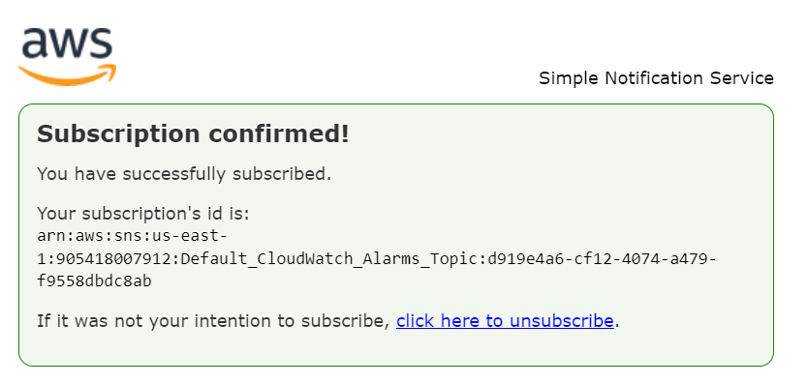
Subscription confirmed

Slide 33
Cost Management & Optimization Project Achievements
Strategic Cost Review and Resource Optimization
Reviewed AWS resource usage periodically, avoiding unplanned expenses and optimizing budget allocation.
Adjusted resource configurations to balance cost savings with performance needs, ensuring a cost-effective solution without compromising on user experience.
Key Milestones and Strategic Wins Post-Deployment
Established a scalable and secure AWS-based email subscription platform, with seamless user subscription management.
Ensured adherence to AWS best practices for security and compliance, fortifying the platform against potential vulnerabilities.
Created a robust infrastructure capable of supporting future business growth and marketing endeavors.

Slide 34
Business Impact
This project isn't just about creating a subscription platform; it's about empowering businesses to enhance their email marketing efforts and drive meaningful engagement with their audience. By leveraging AWS services, businesses can achieve greater efficiency, scalability, and ultimately, business growth.
Improved Audience Engagement: By providing a subscription platform, you can engage with your audience more effectively and build a direct line of communication.
Targeted Marketing: With email subscriptions, you can tailor your marketing messages to specific subscriber segments, increasing the relevance and effectiveness of your campaigns.
Data Collection: The subscription form allows you to collect valuable data about your audience, including their email addresses and potentially other demographic information, which can inform your marketing strategies.
Automation: By integrating AWS services like Lambda and API Gateway, you can automate processes such as sending confirmation emails and managing subscription lists, saving time and resources.
Scalability: AWS provides scalable infrastructure, allowing your subscription platform to handle a growing number of subscribers without performance issues.
By leveraging AWS, the platform ensures high availability, scalability, and cost-effective email marketing solutions, driving increased subscriber engagement and conversion rates.
Business Details: This platform enables efficient email list building, automates subscriber engagement, and lays the foundation for scalable digital marketing campaigns.

Slide 35

Thank you

